Slide 1
Power system fault detection and classification
CAPSTONE PROJECT
– Presented By –
Student Name - Shivam Laxman Dhamankar
College Name - Wainganga College of Engineering, Nagpur
Department - Computer Science & Engineering

Slide 2
OUTLINE
Problem Statement
Proposed Solution
System Approach
Process (Auto AI)
Deployment
Result
Conclusion
Future Scope
References
IBM Certifications

Slide 3
Problem Statement
Design a machine learning model to detect and classify different types of faults in a power distribution system.
Using electrical measurement data (e.g., voltage and current phasors), the model should be able to distinguish between normal operating conditions and various fault conditions (such as line-to-ground, line-to-line, or three-phase faults).
The objective is to enable rapid and accurate fault identification, which is crucial for maintaining power grid stability and reliability.

Slide 4
Proposed Solution
Fault Pattern Analysis :-
1) Use clustering (e.g., K-Means) on fault types with environmental and load data to identify risk zones.
2) Analyze correlation between high temperature, load, and specific fault types (e.g., Overheating).
Predictive Maintenance System :-
1) Train a classification model using features like temperature, current, and component health to predict fault likelihood.
2) Use anomaly detection for identifying abnormal readings.

Slide 5
System Approach
IBM Cloud Lite Services
Watsonx AI Studio (Service)
Watson.ai Runtime
IBM Cloud Object Storage
IBM Cloud Tools (Auto AI)
Windows 11

Slide 6
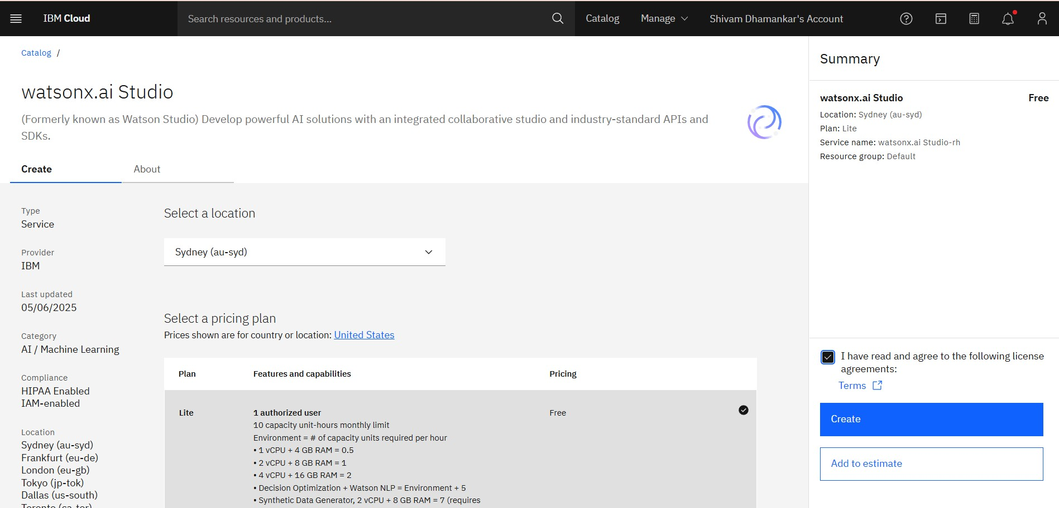
Process (auto ai)

Slide 7
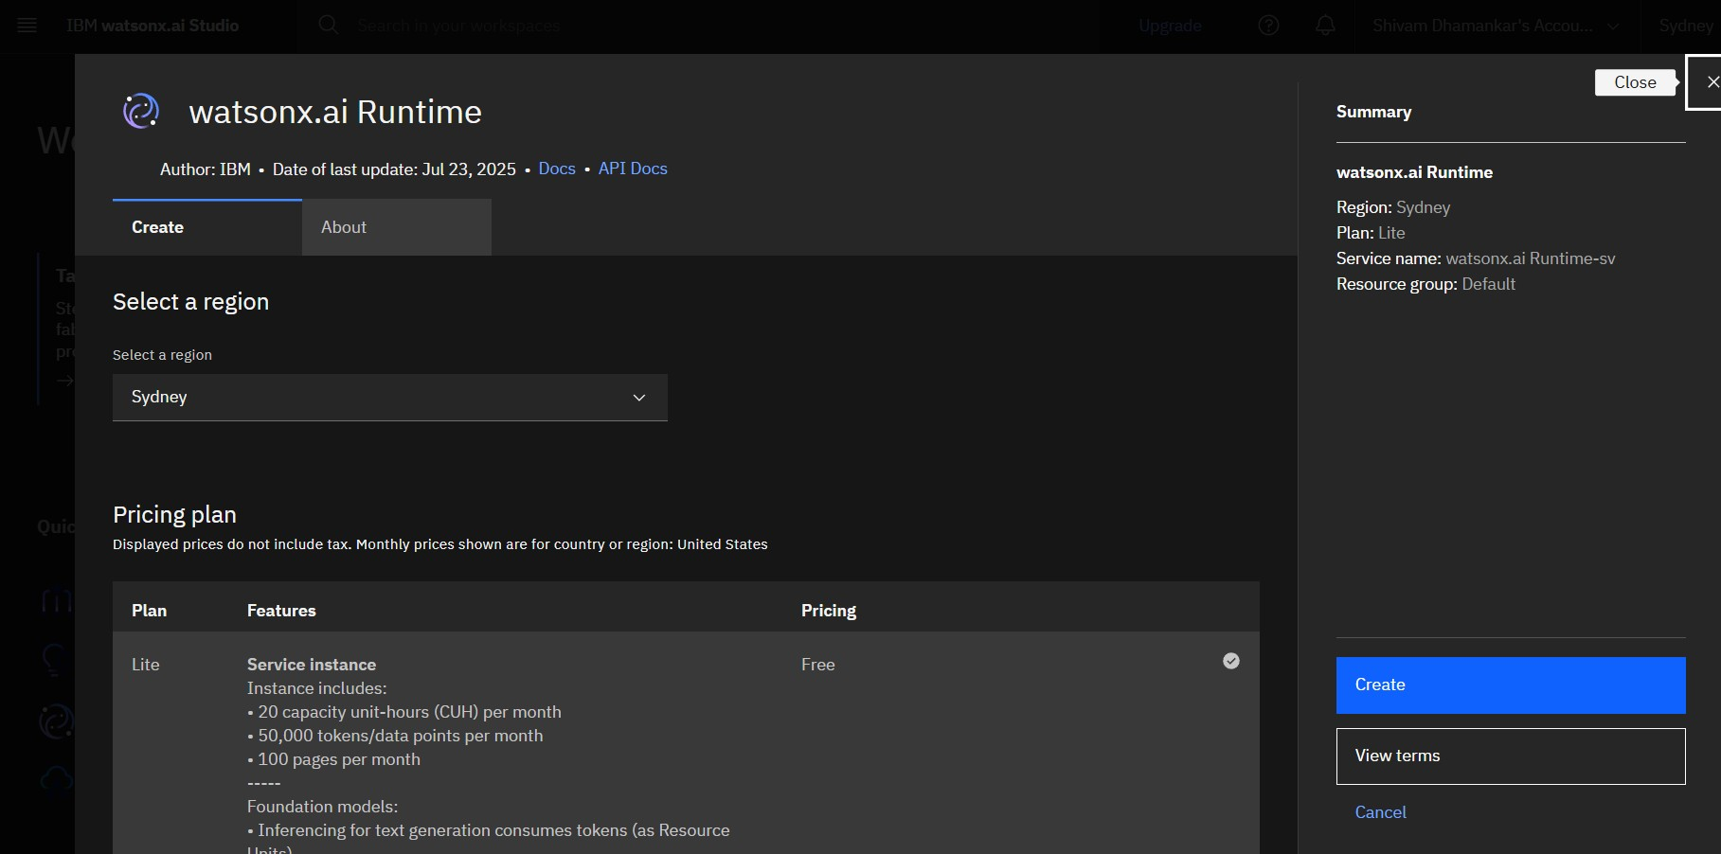

Slide 8
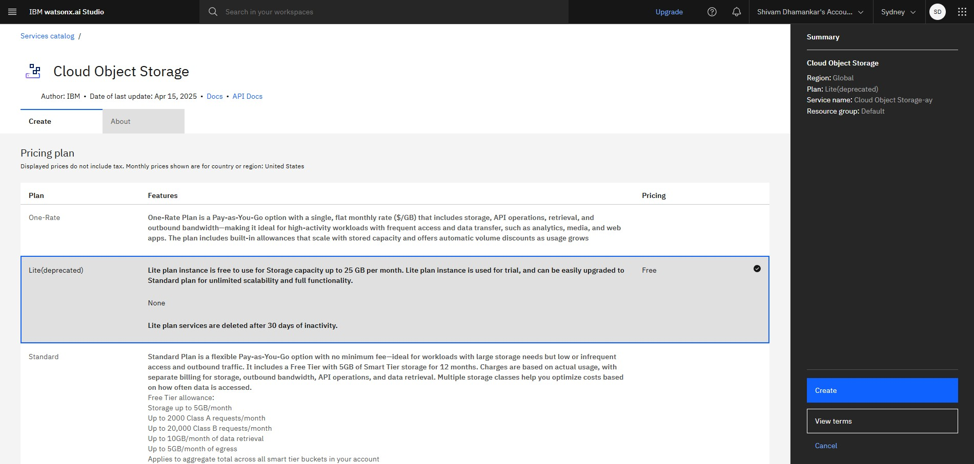

Slide 9
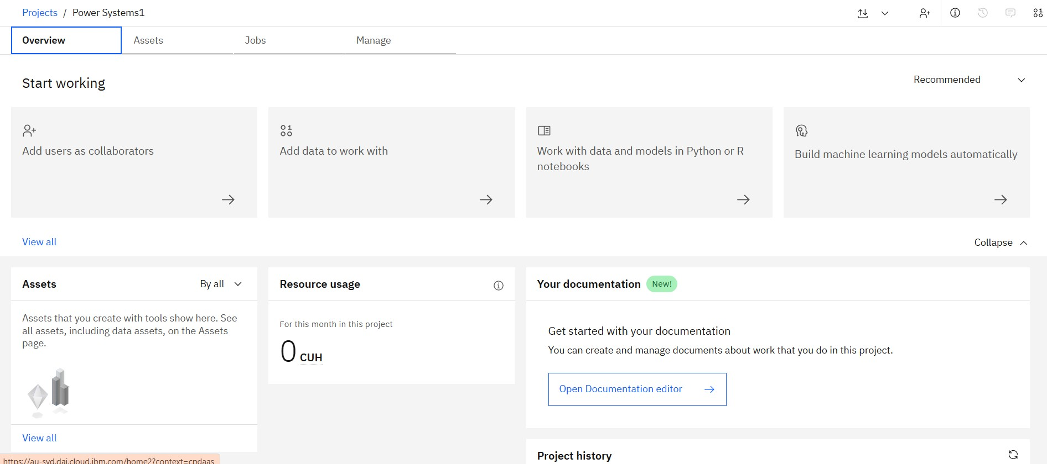

Slide 10
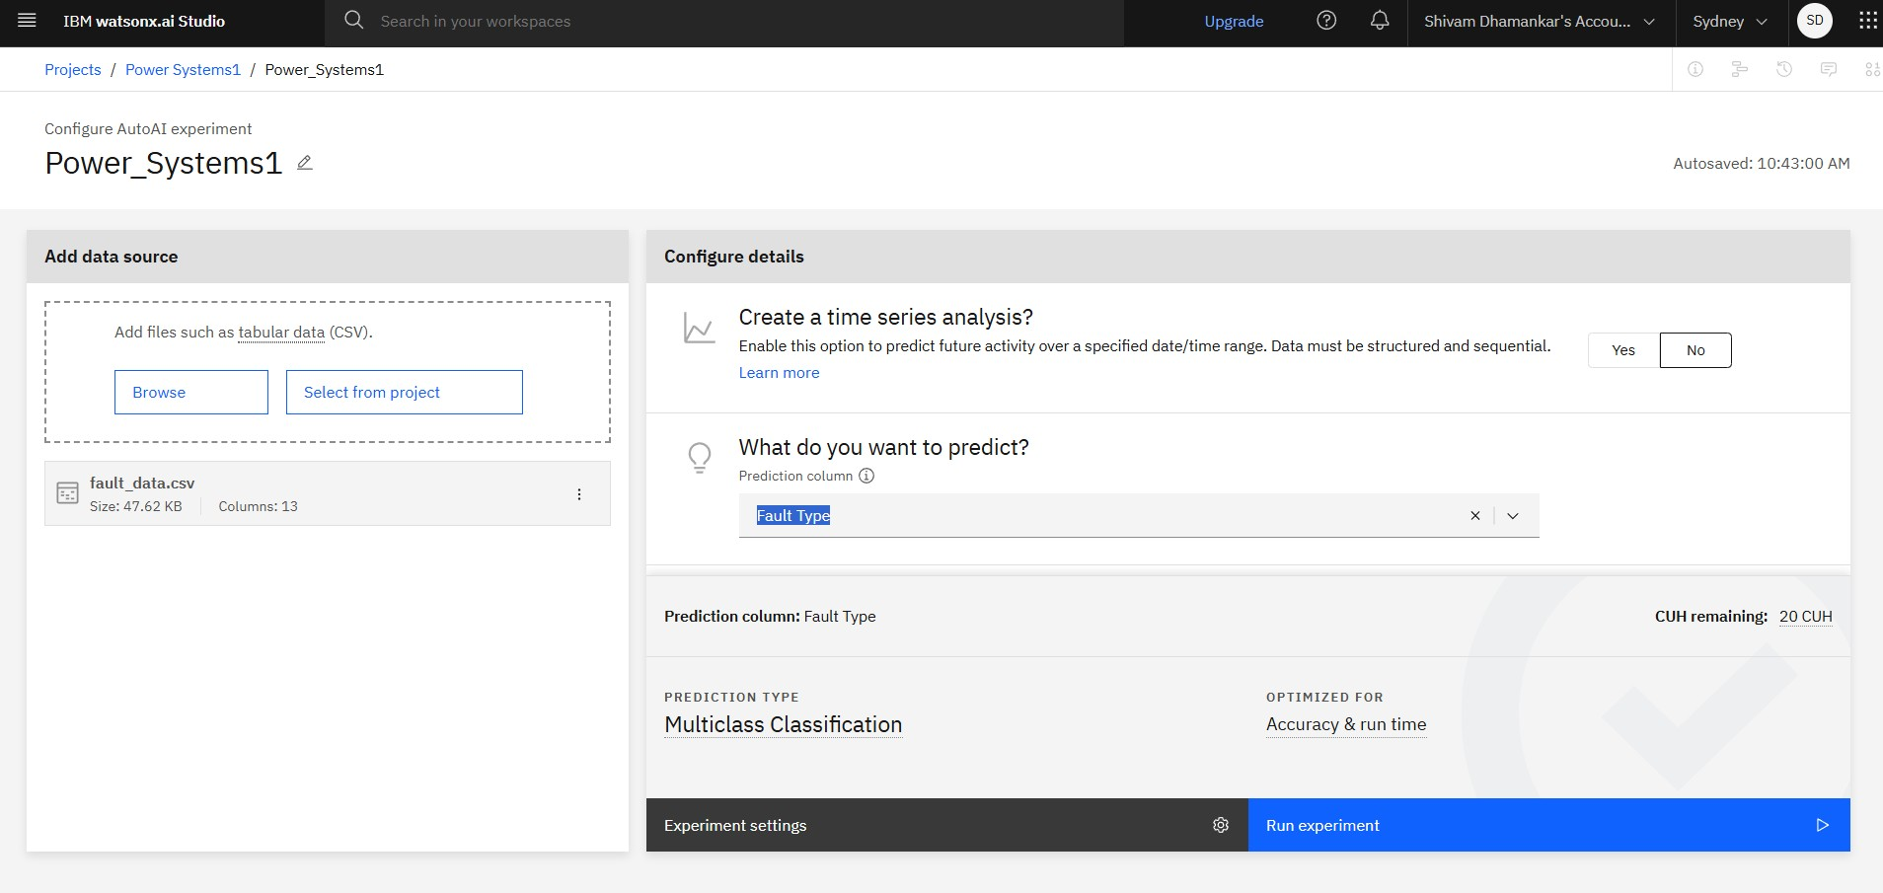

Slide 11
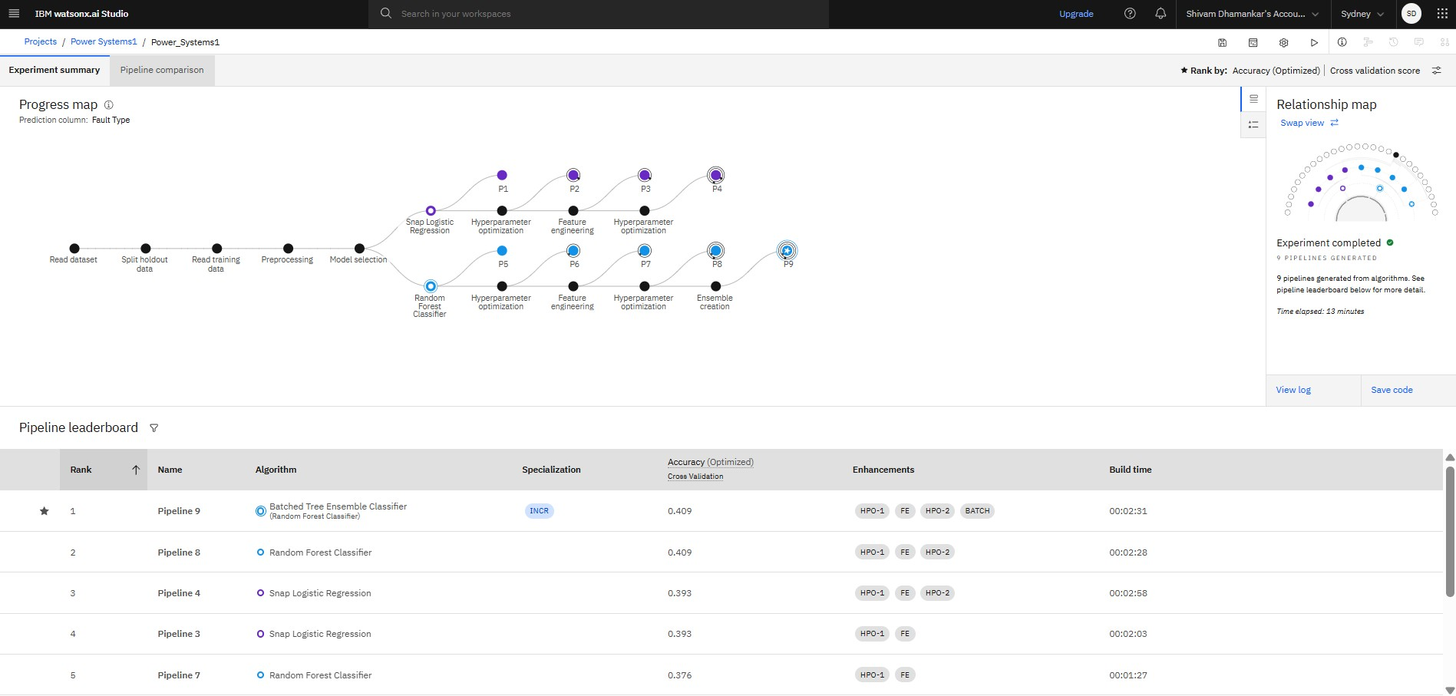

Slide 12
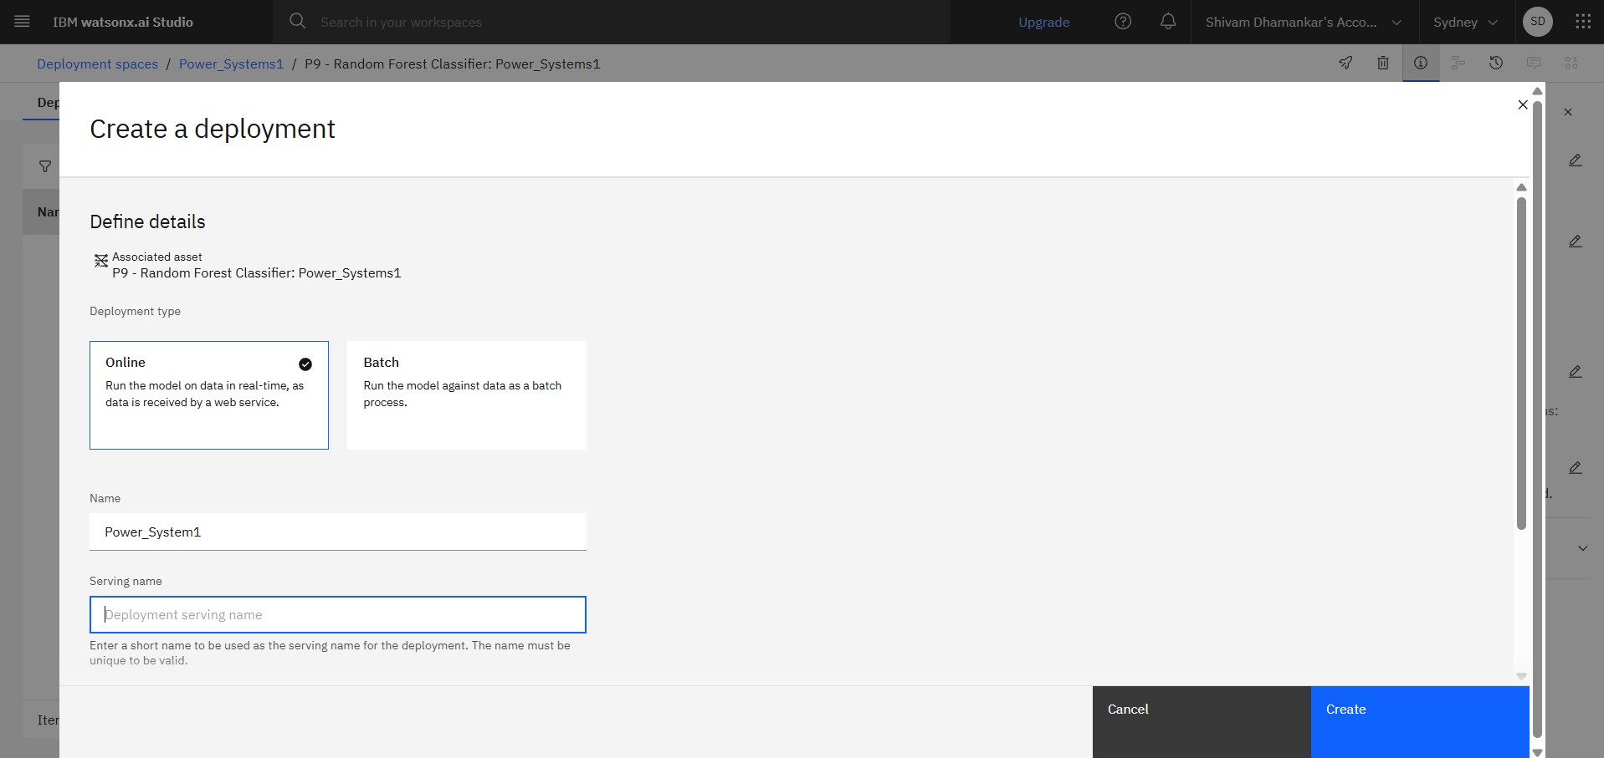
Deployment

Slide 13
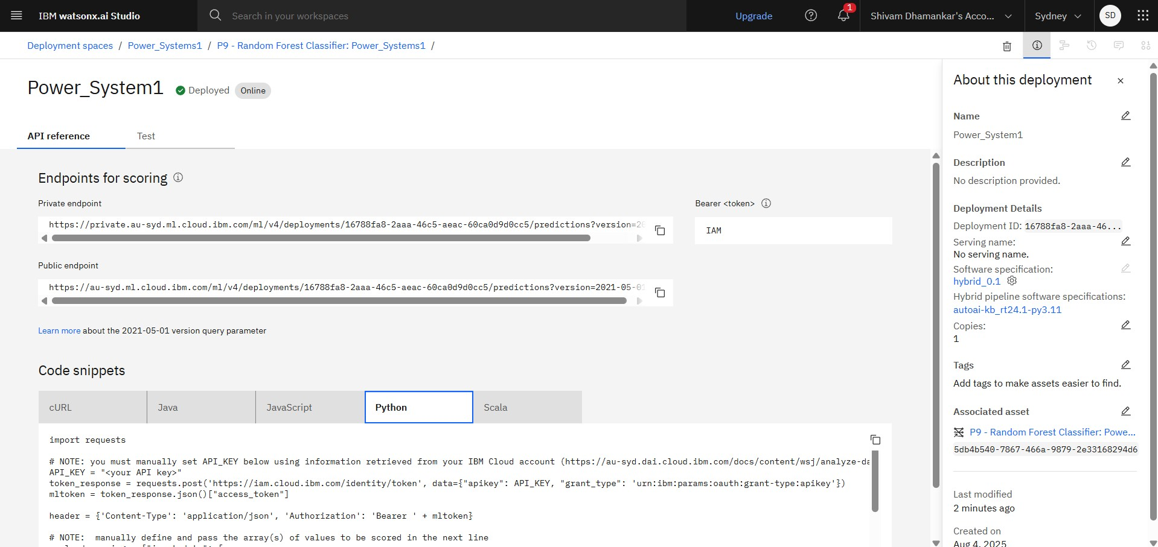

Slide 14
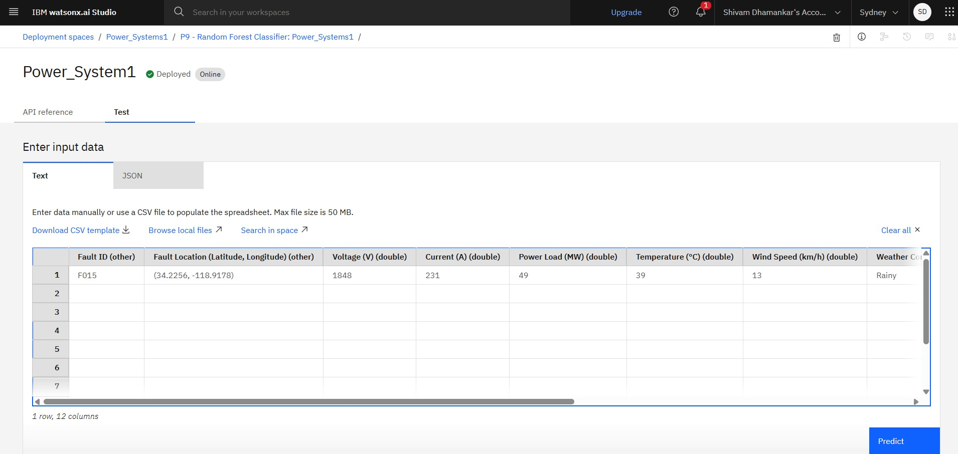
Result

Slide 15
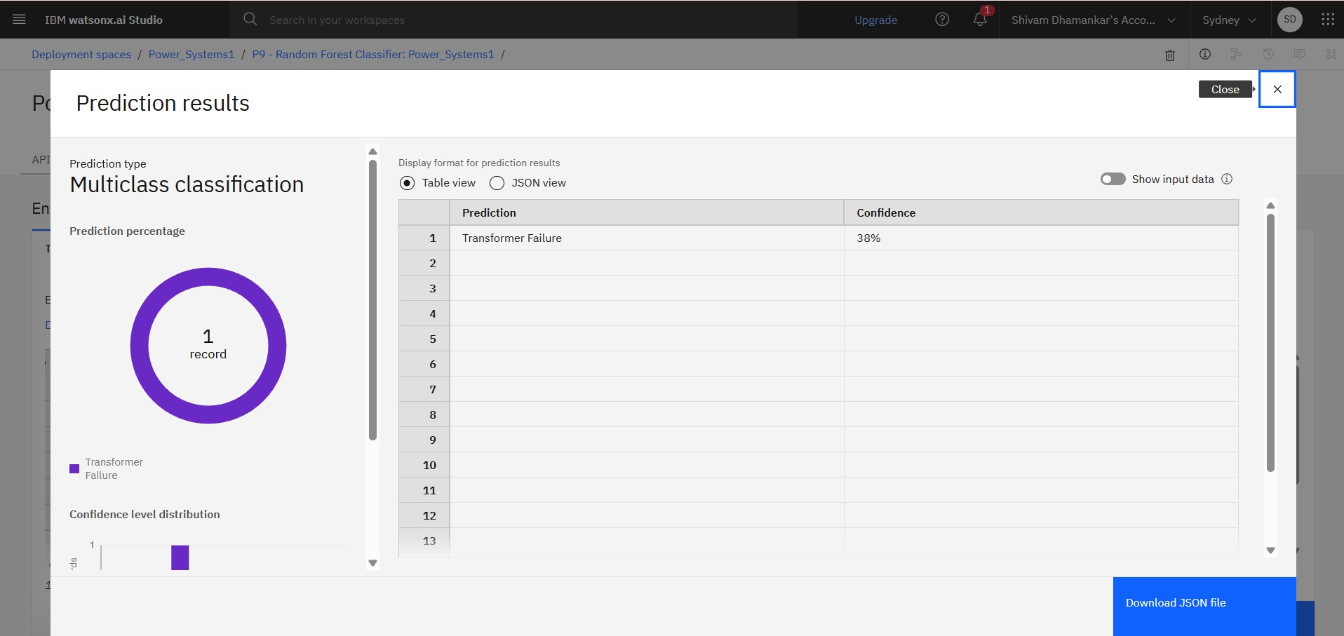

Slide 16
Conclusion
In this project, a machine learning-based approach was designed and implemented to rapidly detect and classify faults in a power distribution system using electrical measurement data, such as voltage and current phasors.
The model was trained to distinguish between normal operation and various types of faults — including line-to-ground (LG), line-to-line (LL), double line-to-ground (LLG), and three-phase faults (LLL, LLLG).
These measurements serve as critical indicators of the operating state of power systems and are essential for making timely decisions during fault conditions.

Slide 17
The future of power system fault detection lies in the integration of intelligent, adaptive, and explainable ML solutions that operate in real-time, across distributed networks, and in concert with other smart grid technologies.
By extending the model's scope to include localization, adaptive learning, real-time deployment, and cybersecurity, this research can play a foundational role in building the next-generation resilient and intelligent power grid.
Fault Localization
Future scope

Slide 18
References
IBM Cloud - https://cloud.ibm.com/
Watsonx AI Studio – https://cloud.ibm.com/catalog/services/watsonxai-studio
Data Sets - https://www.kaggle.com/datasets/ziya07/power-system-faults-dataset
GitHub Link - https://github.com/Shivam200408/Power-System-Fault-Detection-and-Classification.git

Slide 19
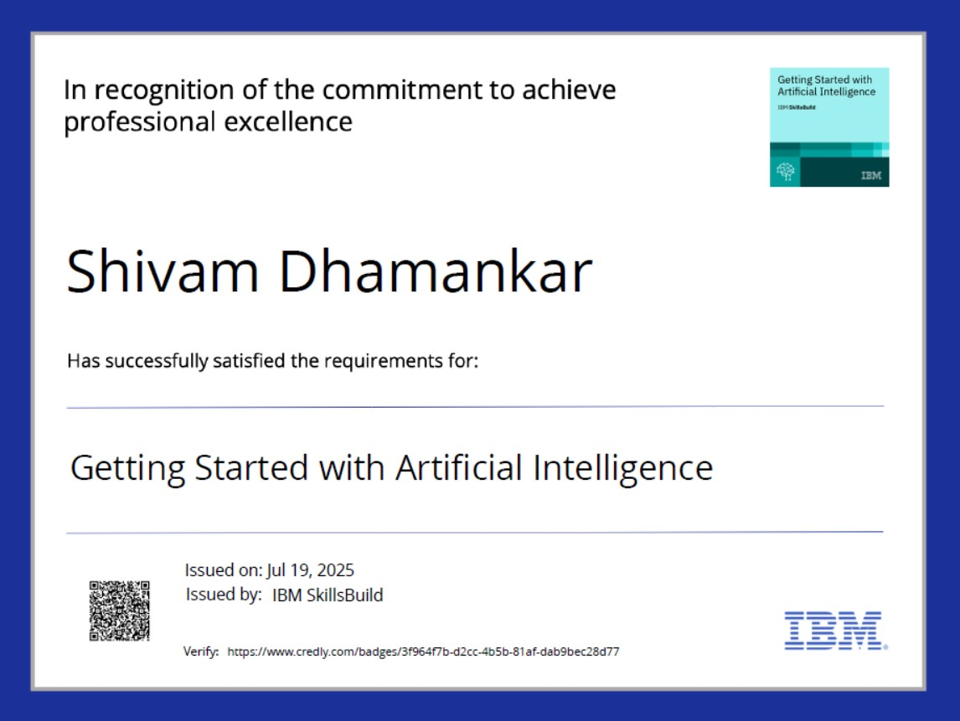
IBM Certifications

Slide 20
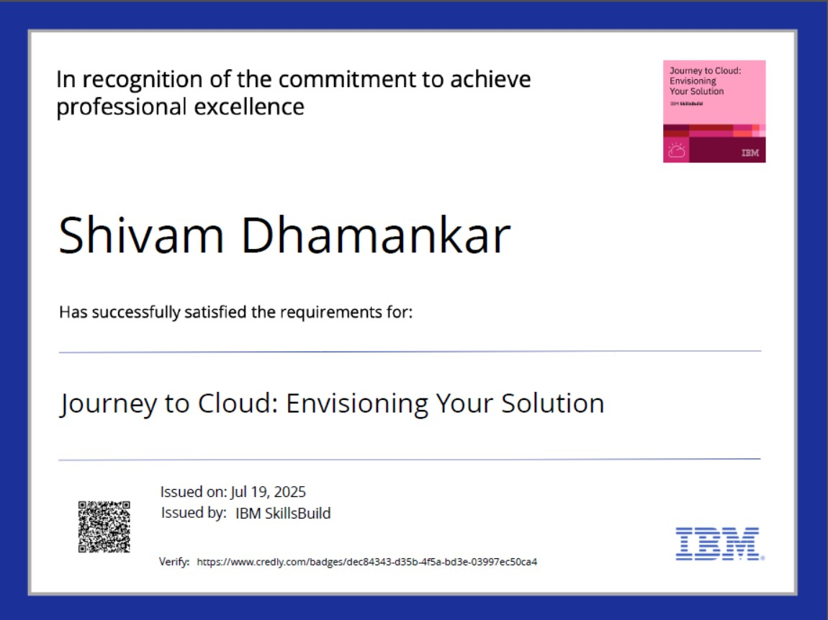
IBM Certifications

Slide 21
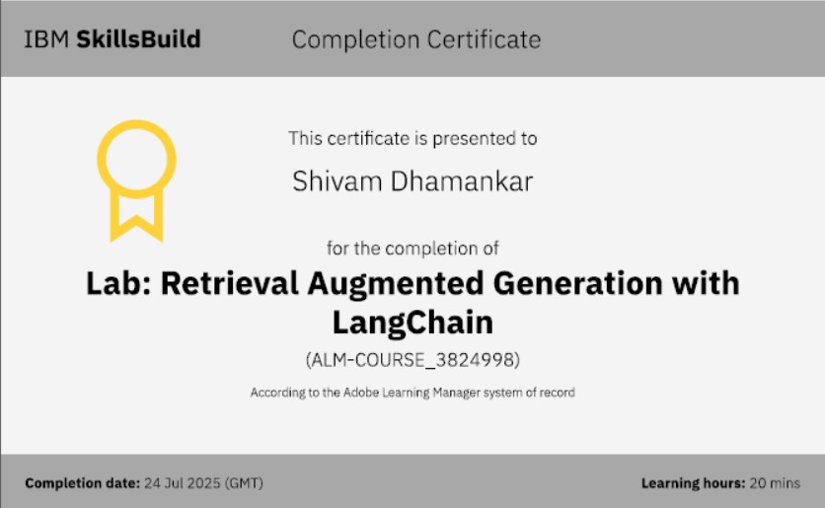
IBM Certifications

Slide 22
THANK YOU

